Slide 1
Employee Data Analysis using Excel
STUDENT NAME : JESSICA SUZANNE J
REGISTER NO : 312209247
DEPARTMENT : B.Com Bank Management
COLLEGE : Anna Adarsh College For Women

Slide 2
PROJECT TITLE
Employee Performance Analysis using Excel

Slide 3


AGENDA
Problem Statement
Project Overview
End Users
Our Solution and Proposition
Dataset Description
Modelling Approach
Results and Discussion
Conclusion
3/21/2024 Annual Review

Slide 4

PROJECT OVERVIEW
1. Objective:
The primary goal of this project is to analyze employee performance data to identify patterns, trends, and areas for improvement. This will help in enhancing overall productivity, aligning performance with organizational goals, and supporting informed decision-making regarding talent management.
2. Scope:
Data Collection: Gather quantitative and qualitative performance data from various sources such as performance reviews, KPIs, productivity metrics, and employee feedback.

Slide 5

WHO ARE THE END USERS?
Human Resources (HR) Professionals:
HR Managers: Use the analysis to refine performance management processes, design targeted training programs, and address performance-related issues.
HR Analysts: Utilize the data to generate insights, develop reports, and support data-driven decision-making in HR.
Department Managers and Team Leaders:
Direct Supervisors: Leverage performance data to evaluate their team members, provide feedback, and make decisions about promotions, rewards, and development plans.
Team Leaders: Use the insights to improve team dynamics, address performance issues, and align team objectives with organizational goals.

Slide 6
Dataset Description
Employee Information
Performance Metrics
Attendance and Work Behavior
Compensation and Benefits
Work Environment and Engagement
Managerial Feedback
Demographics (Optional)
Notes:
Time Frame: Data should ideally cover a significant time period, such as a year, to allow for longitudinal performance analysis.
Data Source: This data can be collected from HR systems, performance management software, employee surveys, and attendance records.

Slide 7
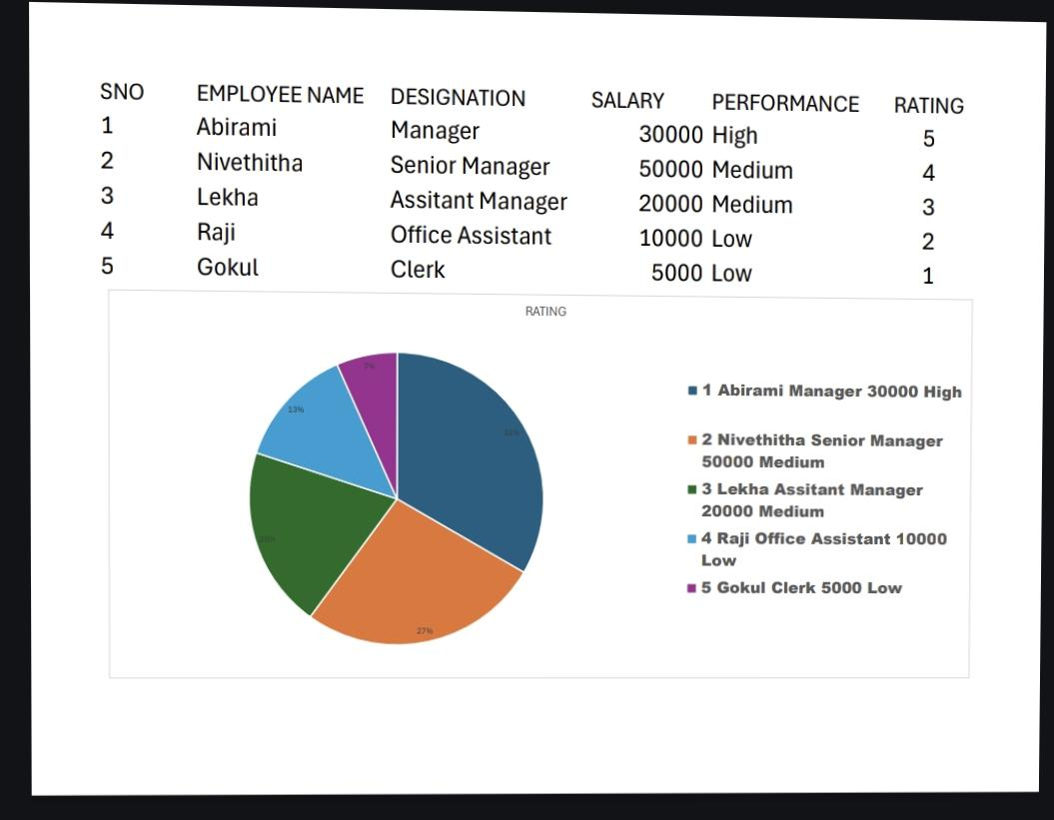
RESULTS
7

Slide 8
Conclusion
Employee performance analysis is a powerful tool for making informed decisions about talent management, rewards, and organizational development. By continuously monitoring and refining performance metrics, organizations can foster a culture of continuous improvement, drive business success, and enhance employee satisfaction and retention. Moving forward, focusing on data-driven performance management strategies will be key to sustaining long-term growth and employee well-being.

